Slide 1
GENERIC DATA TEMPLATE FOR MULTI-ENVIRONMENT FIELD TRIALS
Multi-sheet Excel file template
Uses the ICASA data standard and dictionary
Can be automatically translated to ACE format (JSON file)
Can be automatically uploaded in data bases (in progress for PHIS)

Slide 2
Entity-relation diagram of the ICASA data standards workbook
1:1
Management
1:1
SOIL
Soil_profile*
PK: SOIL_ID
Fields*
PK, FK1: EID FK2: SOIL_ID FK3: WTH_DATASET
1:1
Measured data
Soil_profilelayers*
FK1: SOIL_ID
Env_modifications⁽*⁾
FK: TREAT_ID
Crop and soil per individual plot
Weather
Irrigations⁽*⁾
FK: TREAT_ID
Obs_crop_summary_plots
PK, FK1: PLTID FK2: TREAT_ID PK3: CUL_ID
Weather_metadata*
PK: WST_ID
Fertilizers ⁽*⁾
FK: TREAT_ID
Obs_crop_time_series_plots
PK, FK1: PLTID FK2: TREAT_ID PK3: CUL_ID
n:1
1:1
Plots*
PK: PLTID FK1: TREAT_ID FK2: CUL_ID
n:1
Weather_daily*
FK1: WTH_DATASET FK2: WST_ID
Obs_soil_layer_plots
PK, FK1: PLTID FK2: TREAT_ID PK3: CUL_ID
Genotypes*
PK: CUL_ID
n:1
Dataset metadata
Obs_tensiometer_plots
PK, FK1: PLTID FK2: TREAT_ID PK3: CUL_ID
n:1
Dataset_description
PK: SUITRE_ID
n:n
n:1
Crop and soil means
1:1
Treatments*
PK: TREAT_ID FK1: EID
n:n
1:n
Experiment metadata
Obs_Crop_summary_means*
FK1: TREAT_ID FK2: CUL_ID
Tillage
PK, FK1: EID or TREAT_ID
General*
PK: EID FK1: SUITEID FK2: PP FK3: INP
Obs_crop_time_series_means
FK1: TREAT_ID FK2: CUL_ID
Plantings*
PK , FK1 : EID or TREAT_ID
1:1
n:1
n:1
Obs_soil_layer_means
FK: TREAT_ID
Institutions
PK: INP FK: INP
Persons
PK: PP
Harvest_events
PK , FK1 : EID or TREAT_ID
Obs_tesiometer_means
FK: TREAT_ID
Initial_conditions
PK , FK1 : EID or TREAT_ID
PK: Primary key (unique identifier)
FK: Foreign key (linkage variable)
Initial_condition_layers
FK , FK1 : EID or TREAT_ID
* Mandatory for crop modeling
⁽*⁾ Mandatory for crop modeling if application or modification event exist

Slide 3
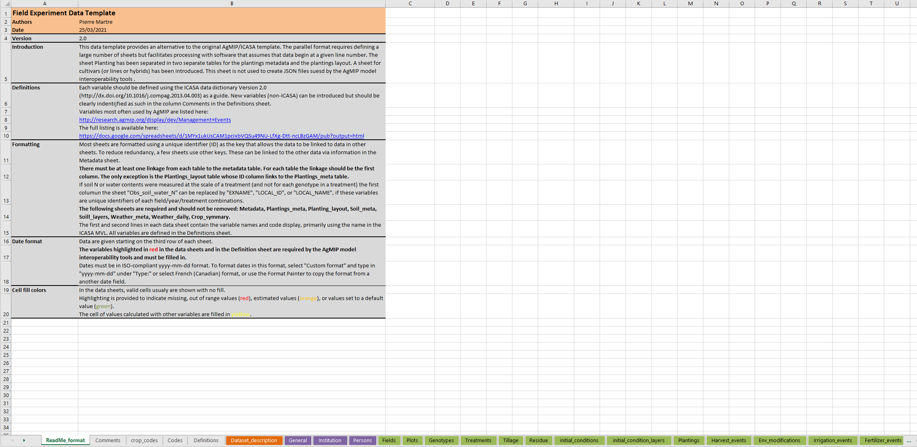
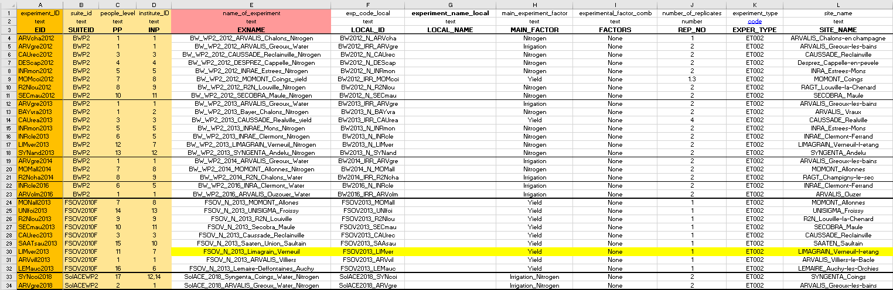
Excel Workbook

Slide 4
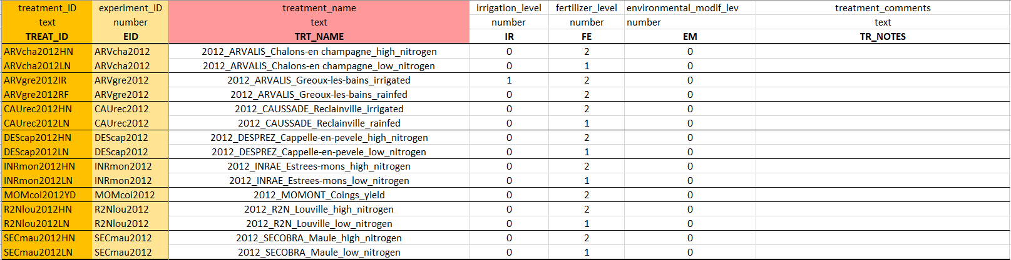
Treatments*
PK: TREAT_ID FK1: EID
Foreign key (link to Experiment_meta data::General)
Primary key
Variable mandatory for modeling (in red)

Slide 5
Soil_metadata*
PK: SOIL_ID
Calculated value (from other variables in the dataset)
Estimated value (e.g. from database)
Out of range value

Slide 6
Comments

Slide 7
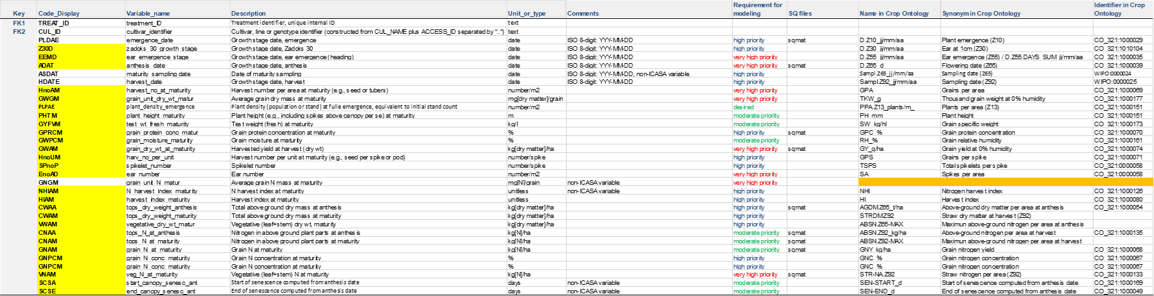
Definitions

Slide 8
Crop codes
Codes
Experiment metadata, crop management, soil, and weather codes

